Slide 1

Introduction to Apache Kafka and Kafka Streams
Sahil Parekh

Slide 2
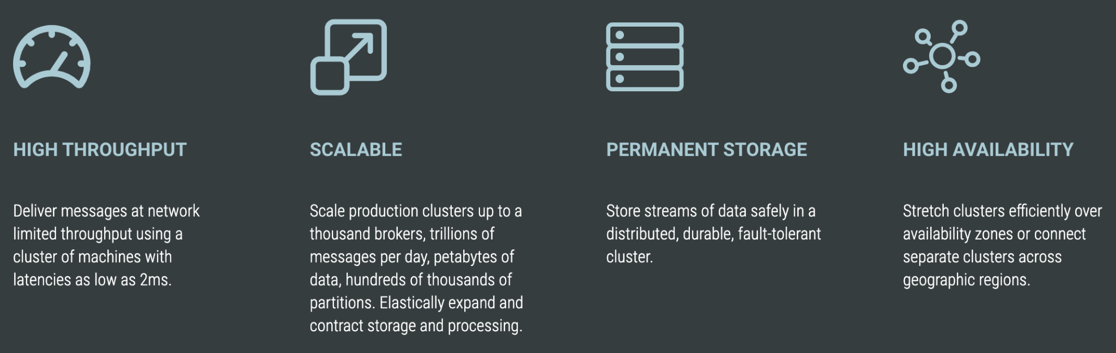
Background and Information
Apache Kafka is a distributed event store and stream-processing platform. It aims to provide a unified, high-throughput, low-latency platform for handling real-time data feeds
It was developed by LinkedIn in 2011 for collecting and delivering high volumes of log data with low latency.
Core capabilities of Kafka:

Slide 3
Why did LinkedIn not use existing systems?
Mismatch in the features offered by enterprise systems then.
IBM Websphere MQ has transactional support
JMS allows each message to be acked after consumption, potentially out of order.
Primary focus was not on throughput
JMS has no API to allow the producer to explicitly batch multiple messages into a single request
Weak distributed support
No partitioning strategy to store messages on multiple nodes
Performance degradation in these systems on large loads
Most systems use a ‘push’ model, i.e, nodes forwarding data to consumers
Unnecessary implementation details exposed

Slide 4
Kafka APIs
Two Primary APIs
Produce : publish
Consume : read
Connect API : To get data into Kafka from external systems
Processing APIs
Kafka Streams
KSQL
Each event in Kafka is stored as a Record
Each Record has:
Timestamp
Key : To enforce ordering
Value
Headers (optional)

Slide 5
Topics
Partitions
Broker
A logical way to organise same type of events together. Analogous to DB Tables
All events are published to a topic are immutable. Topic is append only
TERMINOLOGY
Partition is a unit of data distribution and parallelism. A topic can have 1 or more partitions. Partitions are replicated.
Each partition can be accessed independently and simultaneously by producer and consumer. Kafka provides a total ordering over messages within a partition but not across partitions
Each event (record) in a partition has a unique ID called offset which is a monotonically increasing number. Each event is stored in the partition in offset order and is delivered in the same order
A node in the Kafka cluster.
A broker can be a leader or a follower for a particular partition in a topic

Slide 6
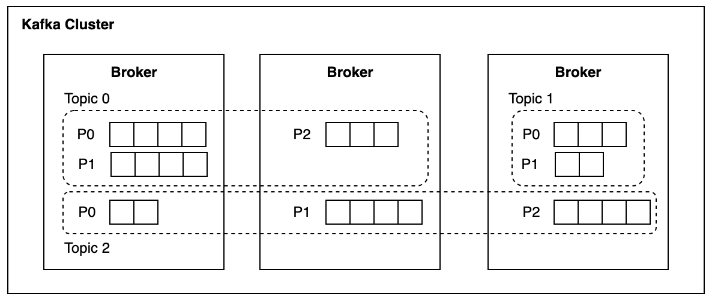
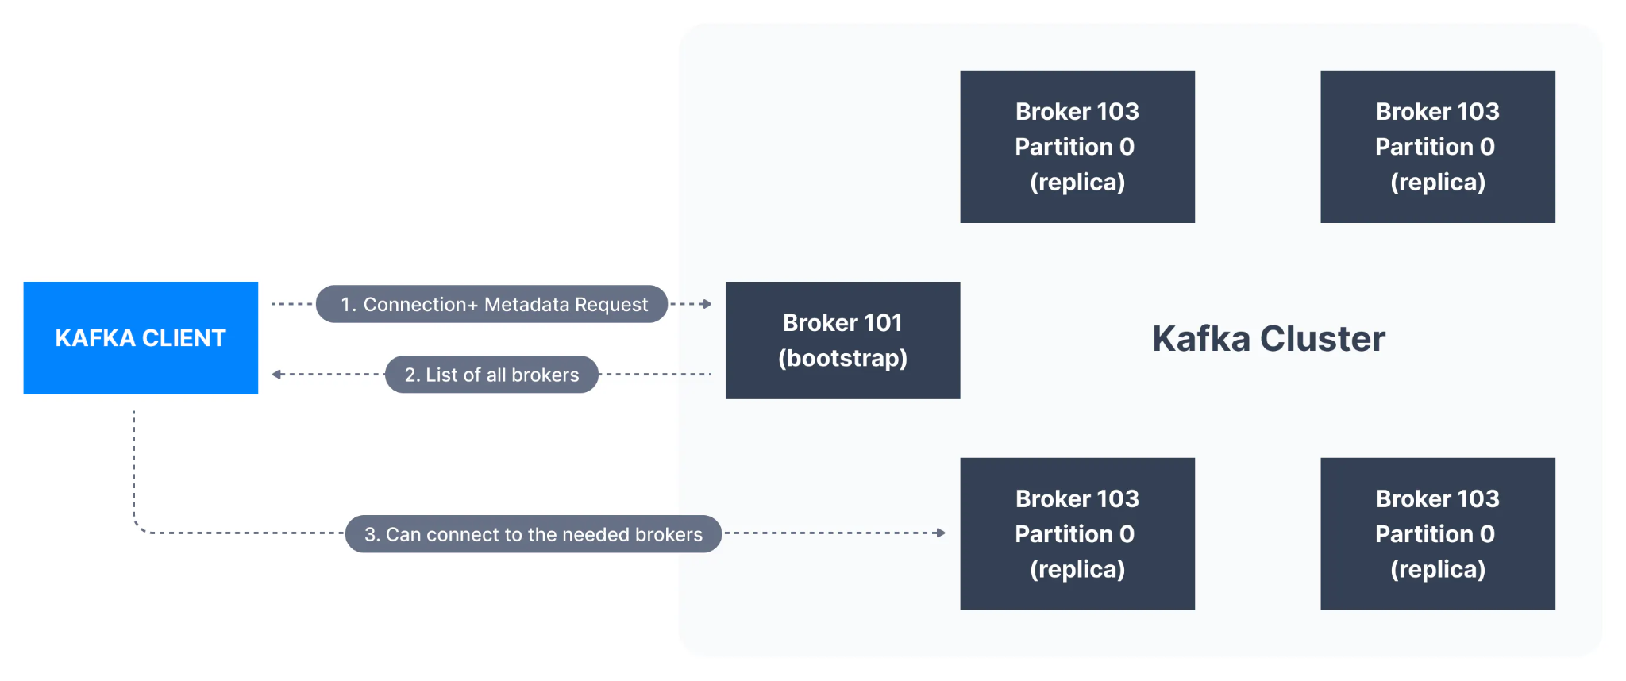
Kafka Cluster, Brokers, Topics and Partitions
Registering a client to the cluster

Slide 7
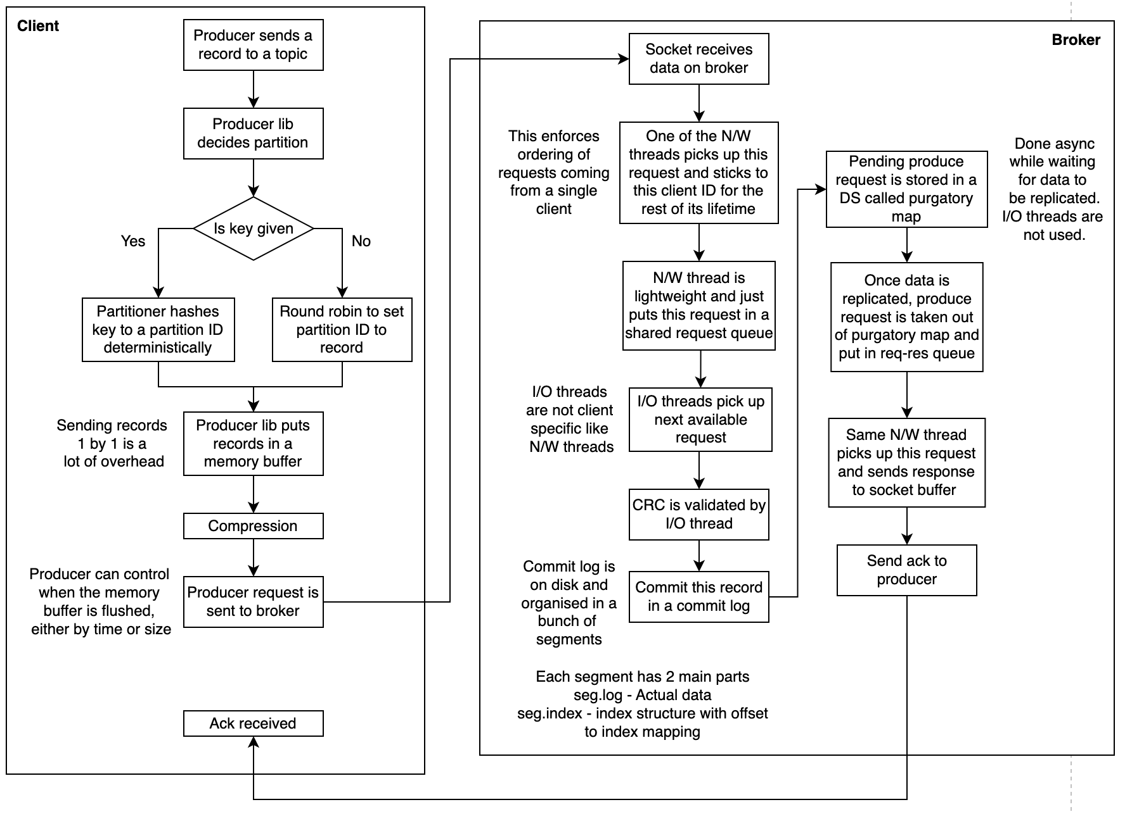
Producer flow

Slide 8
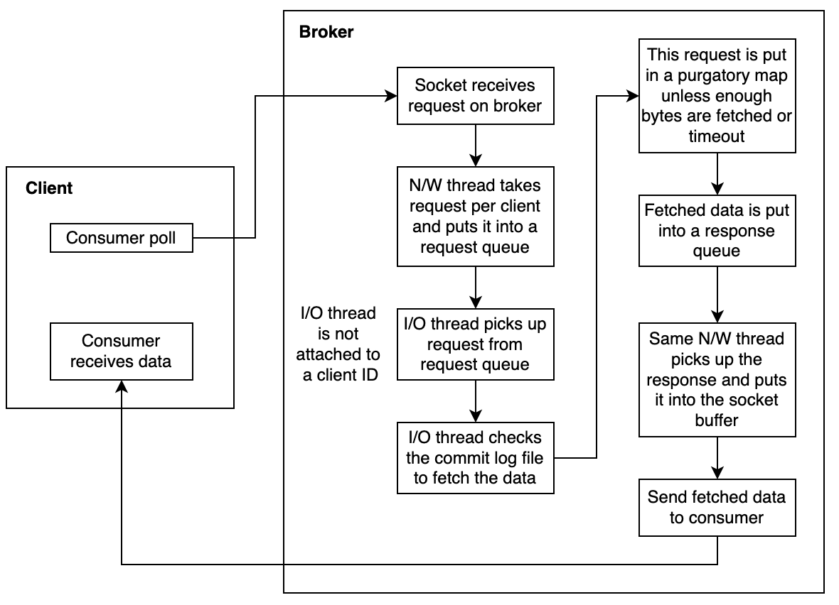
Consumer flow

Slide 9
Consumer Group
Group Coordinator
Consumer group can consist of 1 or more consumers
Load is distributed evenly between consumers of a group and each consumer can process events in parallel. Each partition of the topic is only assigned to 1 consumer in a group. Each consumer can consume from multiple partitions
Is a broker with the following responsibility:
Coordinate consumers in a group
Coordinate assignment of workload to group members
__consumer_offsets topic is used to store metadata about a consumer group. This topic will have multiple partitions spanning across brokers. Group coordinator is decided by the leader of the partition the consumer group ID hashes into

Slide 10
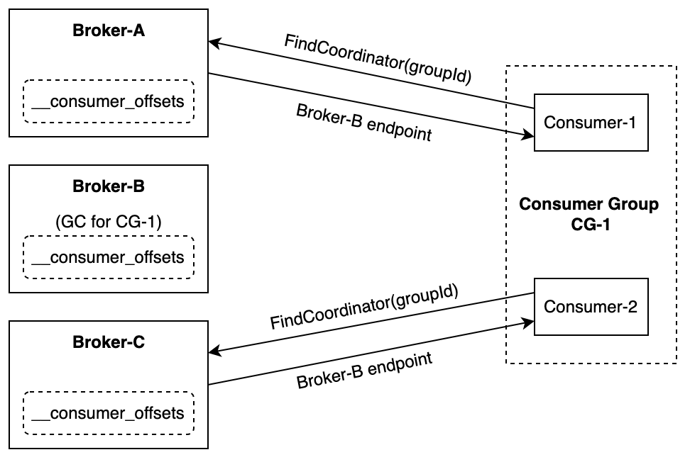
Finding a Group Coordinator

Slide 11
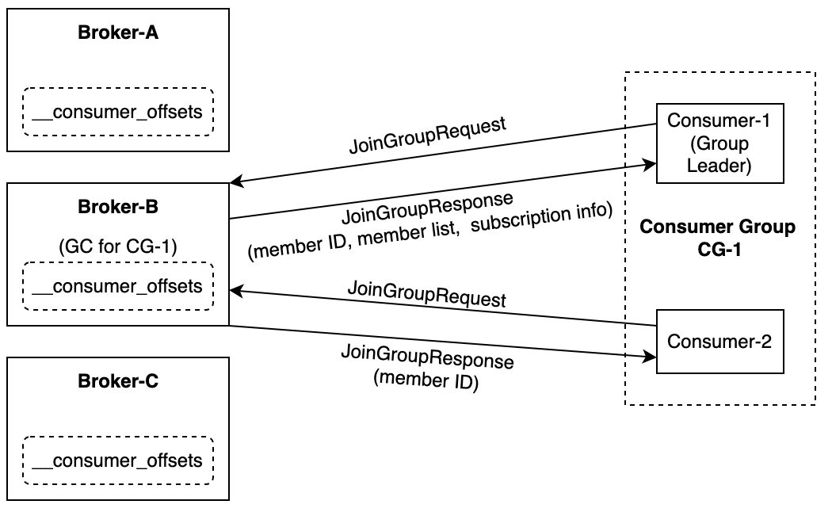
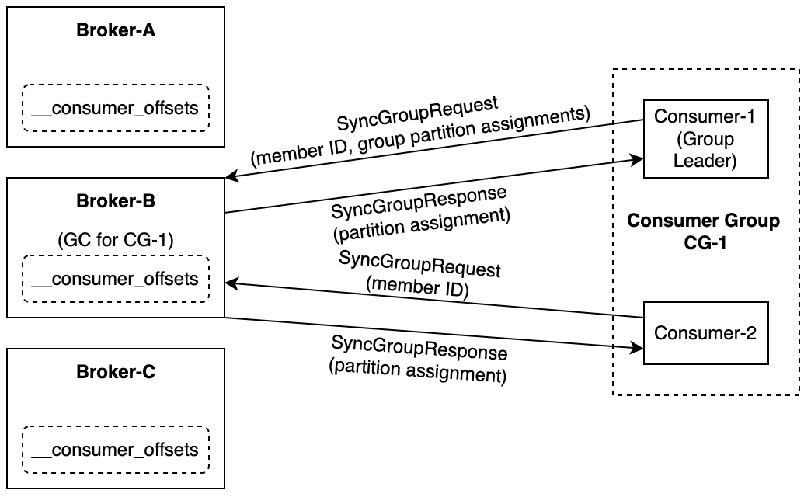
Consumer joining a Consumer Group
Partition assignment by Group Coordinator

Slide 12
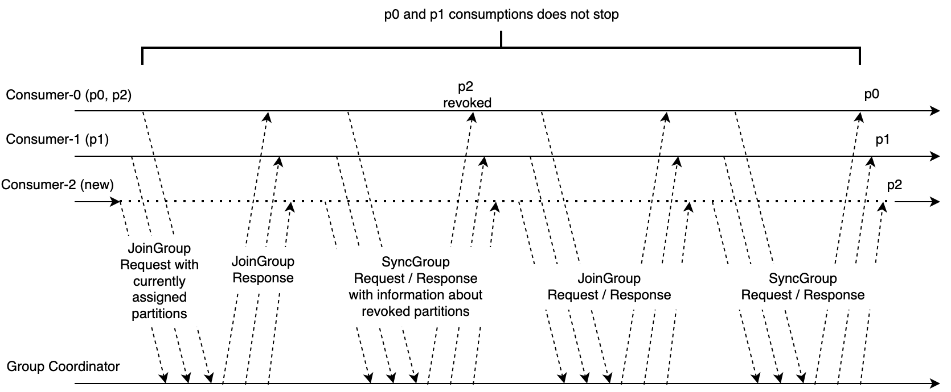
Consumer Group Rebalance

Slide 13
Consensus between brokers
The two modes to synchronize the metadata and configurations between the brokers of a Kafka cluster are:
Zookeeper mode : A separate fault-tolerant service deployed on special brokers called controllers
KRaft mode : Kafka nodes can act as controllers, brokers or both
Each controller knows the address of every other controller
Metadata is kept in a separate topic with 1 partition and is replicated across brokers

Slide 14
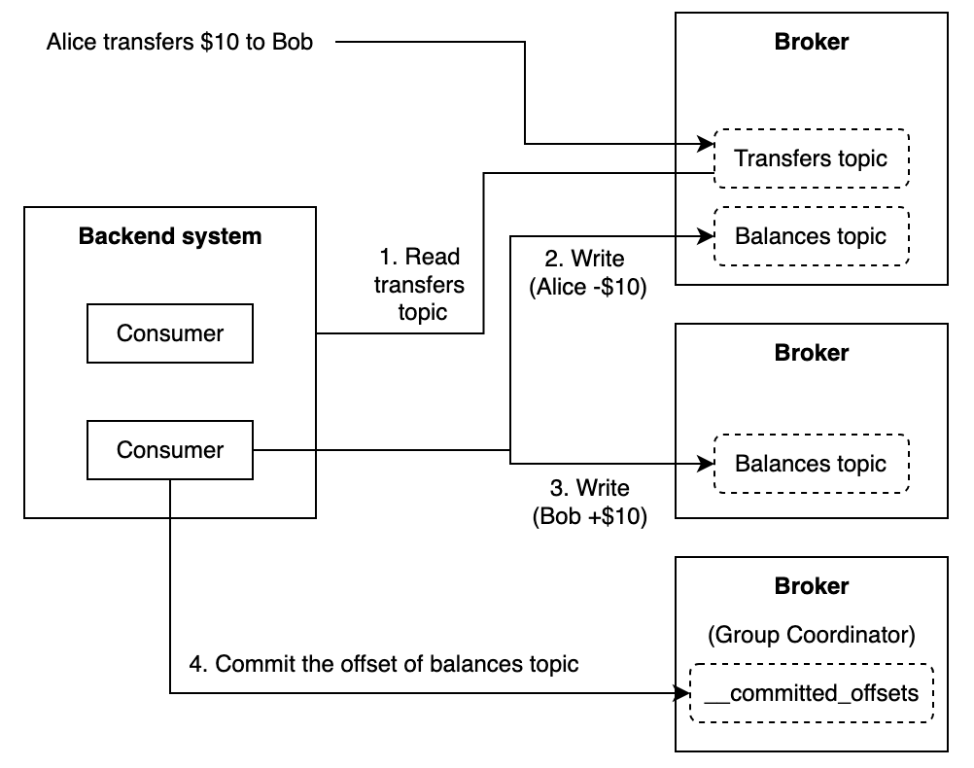
Kafka Transactions
To ensure ACID properties
Taking an example below. All the steps here need to happen atomically.

Slide 15
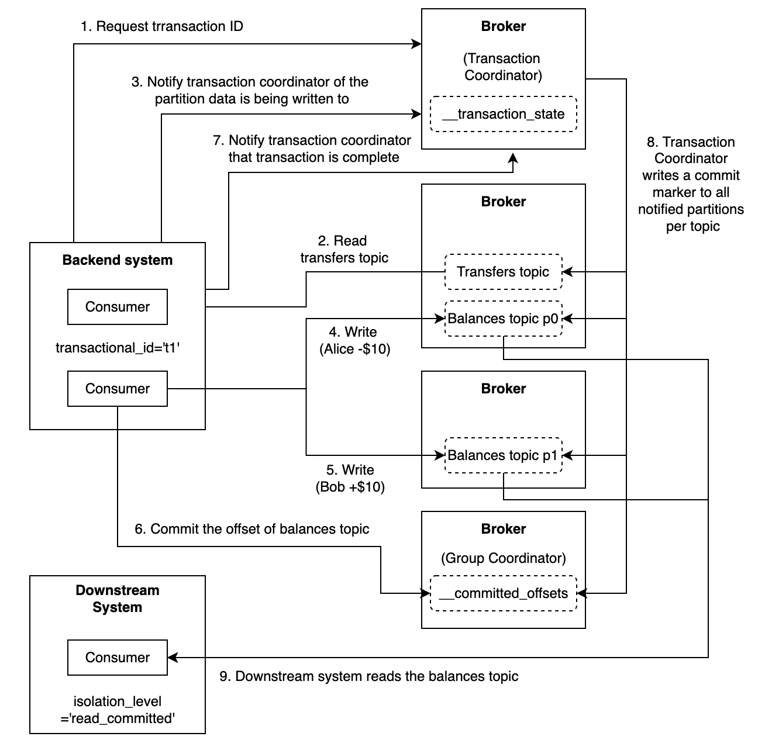
ACID guarantees as provided by Kafka Transactions:

Slide 16
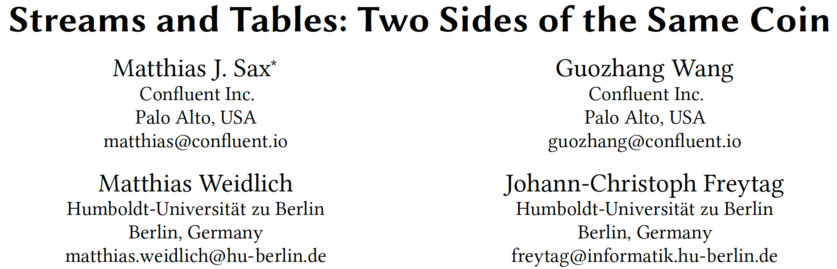

Slide 17
Streams and Tables
Low-latency evaluation of operators over unbounded sequences of data.
In a distributed setting, the physical and logical order of data in a stream may become inconsistent. Existing models either neglect these inconsistencies or handle them by buffering data, therefore compromising processing latency
Dual Streaming Model presented: A result of an operator on a stream is presented as a stream of successive updates
Tables are the materialized view of the stream results

Slide 18
Challenges related to stream processing semantics
Data related:
Process out of order data.
Physical order is the order in which events are produced to a stream processing system. Logical order can be the timestamps of the events. Physical and logical orders can be inconsistent
Operator related:
Avoid implicit operator semantics to obtain deterministic results such as stateful operators need to be based on the logic order of data and not physical
Infinite nature of data streams implies a trade-off between processing cost, latency and result completeness. Need for modelling this trade-off explicitly to help reason about system behavior
System related:
Cannot rely on centralised algorithms to enable distributed evaluation of operators
Data buffering should be avoid as this would compromise processing latency

Slide 19
Data Streams
Data Streams are append-only sequence of immutable records. Each record comprises of an offset, timestamp and some payload. A payload is based on a key-value model with an optional key
A record r is a tumple defined by (o, t, k, v) ∈ ℕ₀ x ℕ₀ x D_{K} x D_{V} where D_{K} and D_{V} are the domains of keys and values, o is the offset, t is the timestamp and k, v is the payload
A data stream is denoted by S = (r₀, r₁, r₂, …..) with r_{i} being a record with r_{i}.o = i
All records in the stream must have the same schema 𝕊 = D_{K} x D_{V} also referred to as the schema of the stream. A data stream S with schema 𝕊 is denoted by S[𝕊]
S is initially an empty stream
Let S = (r₀, ….., r_{n}). Given a new tuple r = (t, k, v) a new record is appended to S to give us S’ = (r₀, ….., r_{n}, r_{n+1}) where r_{n+1} = (n+1, t, k, v)

Slide 20
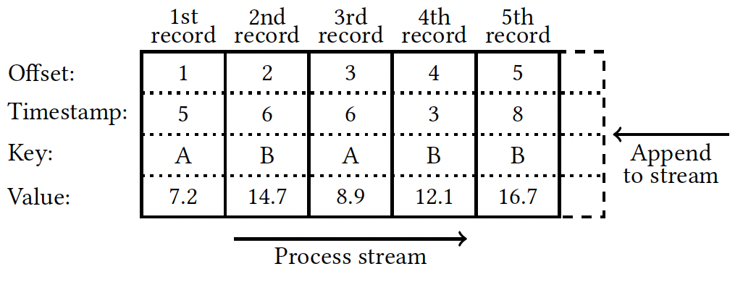
Physical order is a strict total order given by the offsets. Offsets are unique and monotonically increasing set of natural numbers
Logical order is an ordering induced by the timestamp. Timestamps do not need to be unique and thus offsets are used as a tie breaker to derive a logical order that is strict and total over all records
Logical Record Order: Let r and r’ be records of a data stream S. Record r is before r’, as denoted by r < r’ iff r.t < r’.t ∨ (r.t = r’.t ∧ r.o < r’.o)

Slide 21
Duality of Streams and Tables
‘Maximum lateness’ for evaluating operators on out-of-order records is defined as the difference between the timestamp of an out-of-order record r and the largest timestamp of all the records with a smaller offset than r’s offset. Thus latency is dominated by the characteristic of a stream rather than the semantics and implementation of operators
Proposed model is one where the operator result is updated continuously
The result of an operator can be viewed as
Statically, by materializing the processed stream up to a particular offset, OR
A stream of successive updates
Processing a stream of result updates or continuously query the materialized result achieve the same result

Slide 22
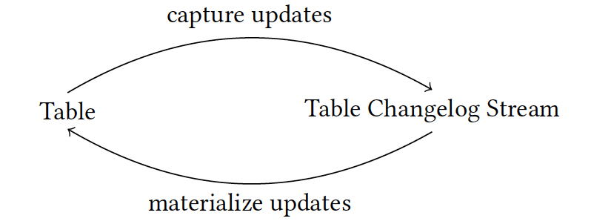
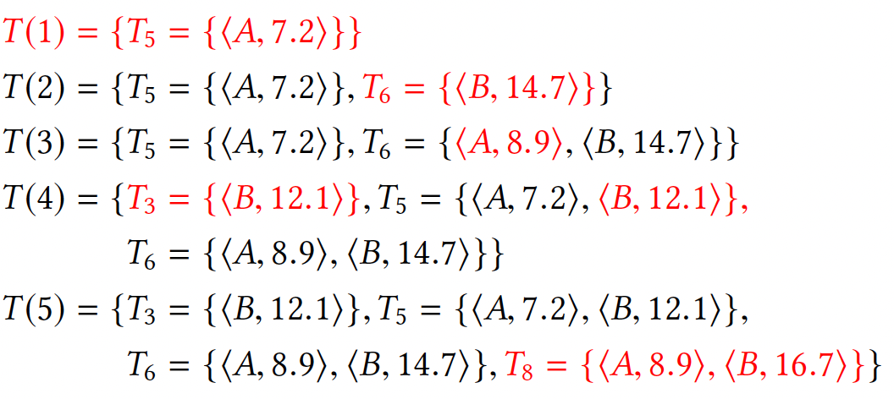
Static view on the current result by an operator is given by a table. Dynamic view on the result of an operator is a table changelog stream. A table is a collection of table versions
To reason about the state of a table. We assign a generation number to it. For each input record, the generation of the table is increased by 1
Records on the right are the ones that have arrived in the stream

Slide 23
Types of Streams
Record Streams
Models immutable facts
Each record should have a unique key over the whole stream
This unique key is represented by ⟂ with ⟂ ≠ ⟂ to denote uniqueness of the keys of the record stream (r.k = ⟂)
Table Changelog Streams
Models mutable facts
Each record should has a key r.k ≠ ⟂
The number of keys in a table changelog stream are finite and therefore the size of a table materialized from a table changelog stream at any point is finite
Ordered Streams
Same physical and logical order
Unordered Streams
Inconsistent physical and logical order

Slide 24
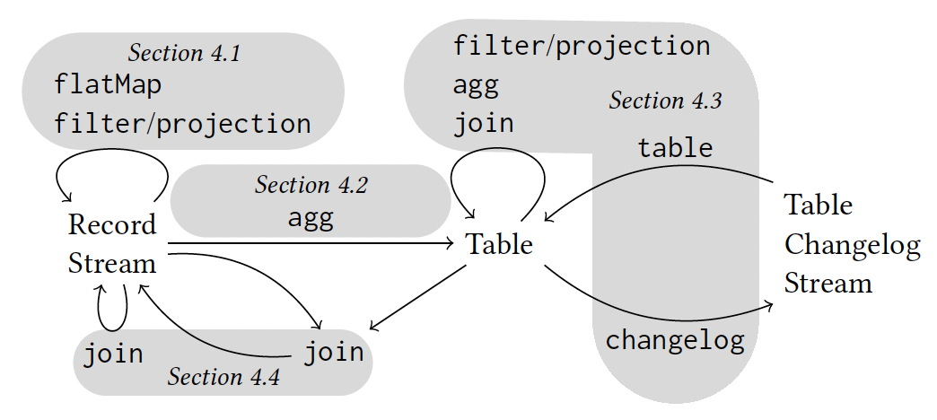
Stream Processing Operators
Operators can be:
Stateful or Stateless
Have multiple input streams or defined on special types of input streams only

Slide 25
Stream equivalence
We define stream equivalence over ordered and unordered streams. We can provide operator definitions over ordered streams and extend them to unordered streams
Two record streams S[𝕊] and S’[𝕊] are equivalent, denoted by S[𝕊] ≡ S’[𝕊], iff their corresponding multi-sets of timestamp-value pairs are equal:
S ≡ S’ ⇔ MS(𝜋_{T,V}(S)) = MS(𝜋_{T,V}(S’))
with MS being an operator which transforms the sequence into a multi-set and 𝜋 being a stream projection that returns timestamp T and value V for every record
Example: Let S[𝕊] be an ordered stream and S’[𝕊] be an unordered stream that contains the same records r, s, t, u and the filter be an operation that filters out s, then both these streams are equivalent
( filter(S) = filter((r, s, t, u)) = (r, t, u) ) = ( filter(S’) = filter((r, s, u, t) = (r, u, t) )

Slide 26
Operator Correctness
Stateless Operators
Given S[𝕊] be an ordered stream and S’[𝕊] be an unordered stream, a stateless stream processing operator O is correct, iff
S ≡ S’ ⇒ O(S) ≡ O(S’)
The output stream records inherit the timestamp of the input stream records
Record Stream Aggregation
Given S[𝕊] be an ordered stream and S’[𝕊] be an unordered stream, an aggregation operator agg is correct, iff
S ≡ S’ ⇒ agg(S) = agg(S’)
We use an equality here since agg yields a table version which is a snapshot of an ever updating result table at a particular point in time

Slide 27
Consider a summation operator that evaluates over an unordered record stream with the below timestamp, value pairs
(3, 2.3), (7, 4.4), (5, 6.1)
Evaluating these records in the correct order of timestamps yields the below table versions
⟨3, 2.3⟩ → T(1) : T₃: 2.3
⟨5, 6.1⟩ → T(2) : T₃: 2.3 , T₅: 8.4
⟨7, 4.4⟩ → T(3) : T₃: 2.3 , T₅: 8.4 , T₇: 12.8
Output table changelog stream = ⟨3, 2.3⟩, ⟨5, 8.4⟩, ⟨7, 12.8⟩
Evaluating them in an out-of-order fashion yields the below table versions
⟨3, 2.3⟩ → Tˆ(1) : Tˆ₃: 2.3
⟨7, 4.4⟩ → Tˆ(2) : Tˆ₃: 2.3 , Tˆ₇: 6.7
⟨5, 6.1⟩ → Tˆ(3) : Tˆ₃: 2.3 , Tˆ₅: 8.4 , Tˆ₇: 12.8
Output table changelog stream = ⟨3, 2.3⟩, ⟨7, 6.7⟩, ⟨5, 8.4⟩, ⟨7, 12.8⟩

Slide 28
Completeness vs Cost trade-off
The result table of an aggregation grows unbounded since we have to maintain a history of all the table versions
A retention-time parameter can be used to define how long an element in the result table can be maintained
This makes the trade-off between result completeness and storage requirements for a system very explicit without introducing any additional latency

Slide 29
Table Operators
Tables can be materialized from a table changelog stream or the result of an aggregation
A table operator is one that materializes a table from a table changelog stream. Some of the operations allowed are as follows:
Filter
Limited form of Map (not permitted to alter table’s primary key)
Limited form of Projection (not permitted to alter table’s primary key)
Aggregations
Joins over primary keys
Semantics of above operations follow a temporal-relational model. Updates on an input version triggers updates on an output version

Slide 30
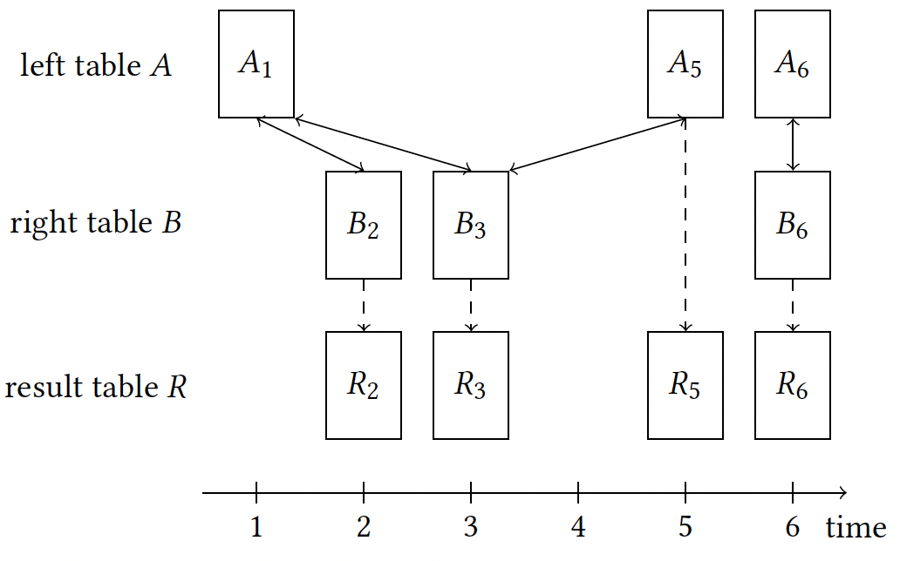
Table-Table join
Defined over corresponding table versions with allowance to use old table version on either side of the join if a current table version is not available
Example given below:

Slide 31
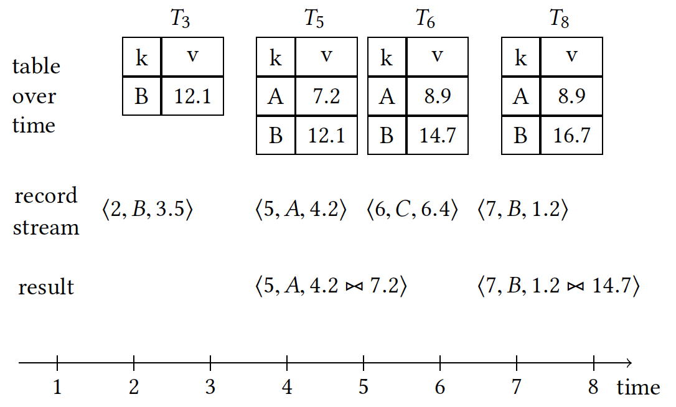
Stream-based joins
Variety of equi-join operators for Stream-Stream and Stream-Table joins
Stream-stream joins are based on join attributes as well as a sliding window.
A stream-table join is a temporal join: The table lookup is done into the table version corresponding to the stream record’s timestamp. Thus, a stream record can only join with table records with a timestamp less than or equal to the record’s timestamp. The join result record inherits the timestamp for the input stream record. Streams drive the result in Stream-Table joins

Slide 32
Handling out-of-order records
No special handling required for stream-table joins but out-of-order table updates could yield incorrect results
Solution: Buffer record stream input record in the stream-table join operator and re-trigger join computation for late table updates. Thus, if a late table update occurs, corresponding update records are sent downstream to “overwrite” previously emitted join records.
Result of stream-table joins is not a record stream but a regular data stream because it might contain update records
Same technique for left and full outer joins. Records with no join partner are emitted as join results eagerly and might be updated later.
No out-of-order handling required for inner stream-stream joins since it is a monotonic operation that will never yield an early result which needs to be updated later on
Advantage: Ability to implement joins in a fully non-blocking manner

Slide 33
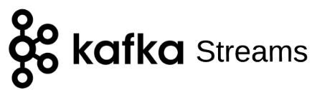
Client library to write your own stream processing application and process data in Kafka

Slide 34
Types of Streams
Processor Topology
Event Streams
Unbounded sequence of records with key-value pairs
Contains immutable records. A subsequent record with the same key is a different record
KStream - abstraction over event streams in Java
Update Streams
Key-value pairs with mutable records. A subsequent record with the same key is an update on the previous record
KTable - abstraction over update streams in Java
KTable stores all values temporarily by using a State Store to find the latest value at a particular time
DAG with vertices as processing nodes and edges as flow of event streams. Each processor topology has:
Source nodes
User processor node
Sink nodes

Slide 35
More on KTables
KTable by default does not forward every change downstream unlike a KStream where every event is its own event and is thus forwarded downstream
The updates for a KTable are buffered in a cache. These updates are only forwarded down in the processor topology when the cache gets flushed. By default, the cache flush time, aka the commit interval, is 3 seconds
KTable is a ‘slice of events’ from a particular stream from a given point in time to current time
Global KTable: KStreams and KTables only deal with a subset of the partitions of a topic. Global KTable holds records across all partitions

Slide 36
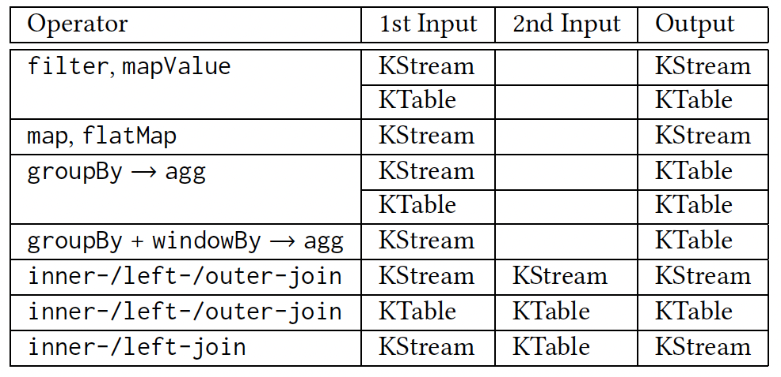
Operations

Slide 37
Joins
Stream-Stream join
Windowed join
Join events based on a common key
Keys are available in a read-only mode
All data for that window is stored in a local state store
Stream-Table join
Non-windowed join since stream is always joined with the latest table
Table-Table join
Non-windowed join

Slide 38
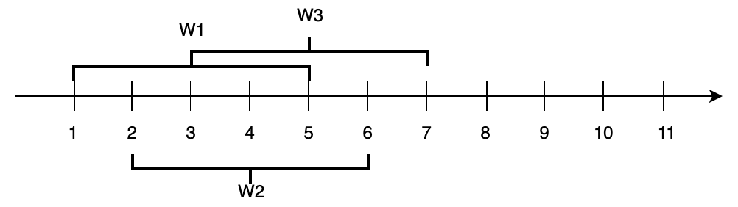
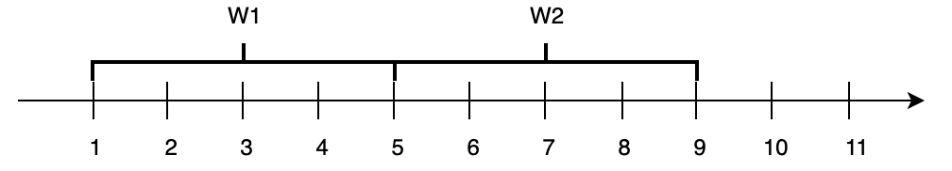
Stateful operations
Windowing
Reduce 2. Aggregation 3. Windowing
Tumbling Window
Hopping Window
Session Window
Inactivity gap between events defines the window boundaries
Sliding Window
Window result only changes when a new event comes in or an old event goes out
Grace Period is defined as the amount of time you are willing to accept new records that fit into a window after the window has ended. Used to deal with out-of-order records

Slide 39
Processor API
Low level API to create your own topology
Used for cases where the defined DSL is not useful
Direct access to state stores as opposed to in previous operators

Slide 40
Demo results
Kafka Papers:
Most Common Words | Most Common “Filler” Words
data: 598 stream: 548 messages: 430 kafka: 410 consume: 359 systems: 327 table: 275 record: 245 times: 220 partition: 211 | the: 2536 of: 1273 to: 1215 and: 1092 in: 885 is: 623 for: 535 that: 443 we: 437 as: 377

Slide 41
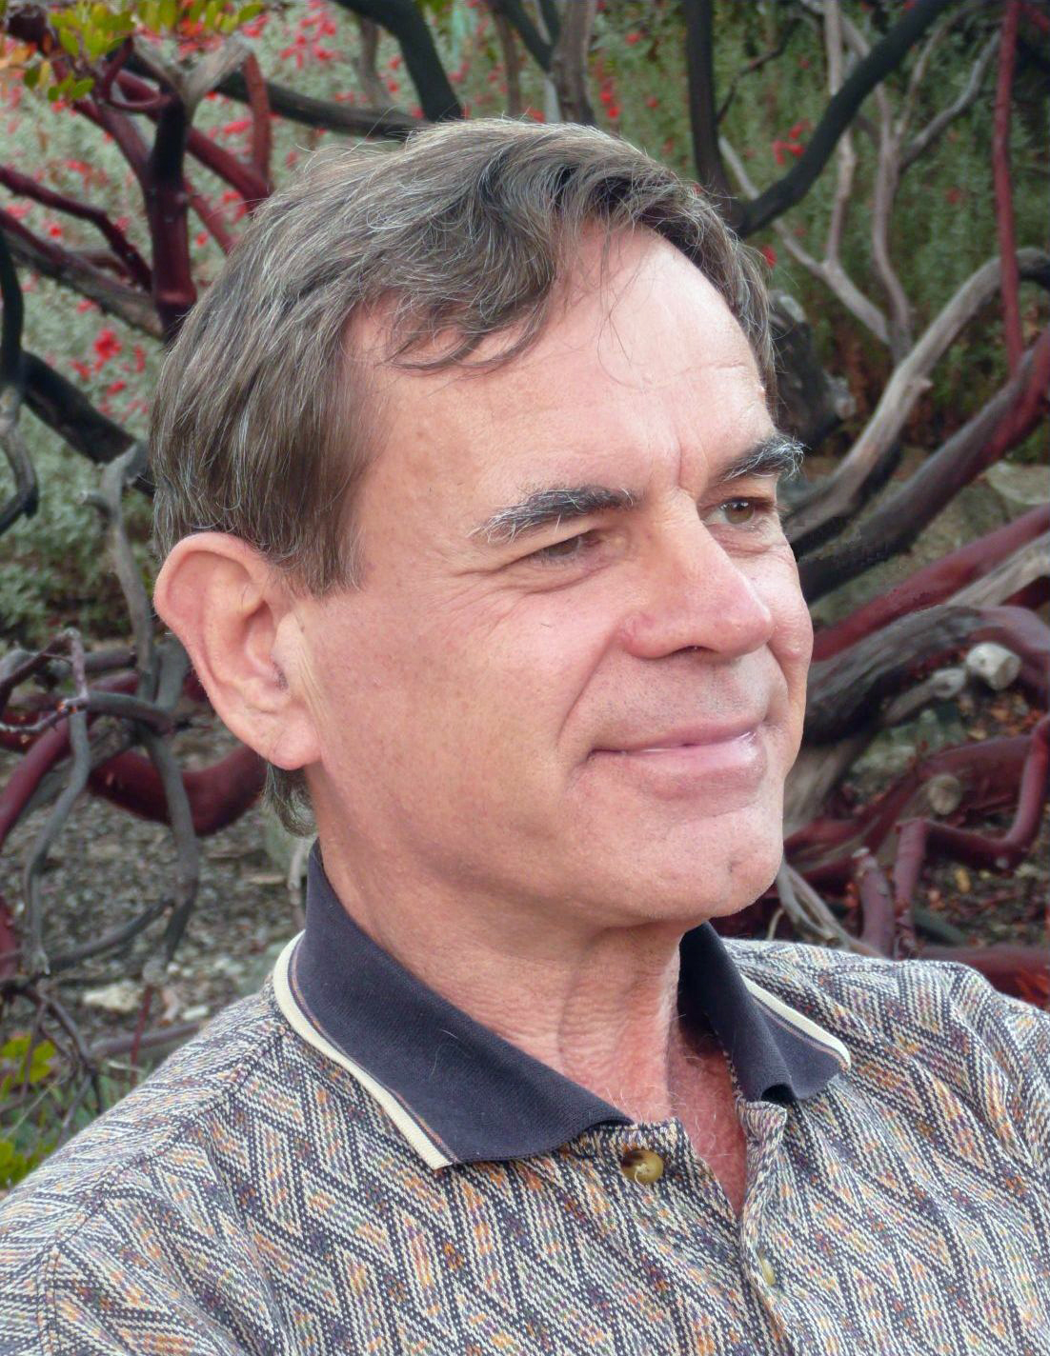

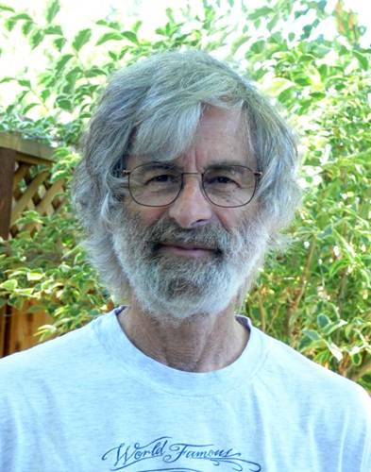
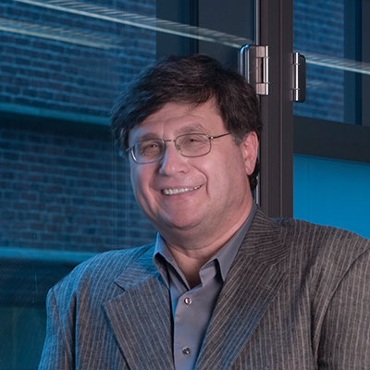
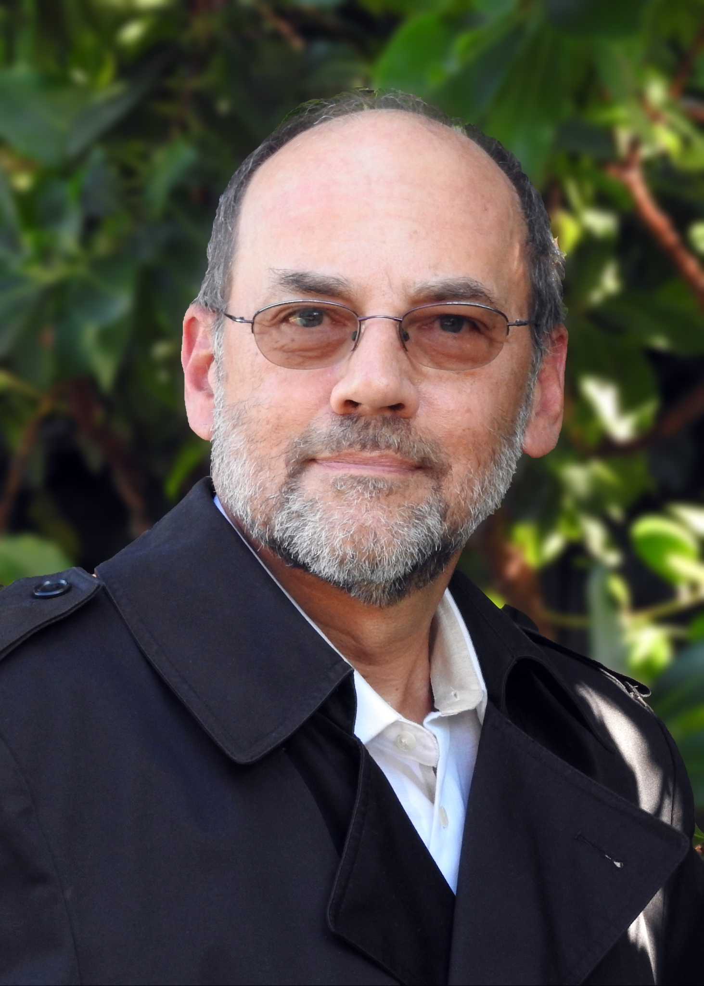
Match the computer scientists with their most used words
messages: 393 state: 312 systems: 288 tokens: 268 decree: 232 | ballot: 215 val: 214 processor: 208 tim: 187 events: 173
actor: 322 timed: 310 dataflow: 290 processor: 257 firing: 221 | function: 203 systems: 195 languages: 193 mod: 191 graph: 190
Vaughan Pratt
stream: 382 seta: 291 ka: 231 dat: 211 function: 198 | semantics: 196 languages: 193 expression: 188 input: 186 example: 177
Konstantinos Mamouras
agent: 350 dat: 258 sets: 243 systems: 218 variables: 217 | program: 194 mod: 184 simulation: 183 datalog: 179 query: 176
Leslie Lamport
sets: 223 events: 150 space: 128 tim: 107 chu: 106 | pomsets: 101 ordered: 95 comonoids: 93 state: 91 two: 78
Val Tannen
Edward Lee (and Thomas Parks)

Slide 42
agent: 350 dat: 258 sets: 243 systems: 218 variables: 217 | program: 194 mod: 184 simulation: 183 datalog: 179 query: 176
stream: 382 seta: 291 ka: 231 dat: 211 function: 198 | semantics: 196 languages: 193 expression: 188 input: 186 example: 177
sets: 223 events: 150 space: 128 tim: 107 chu: 106 | pomsets: 101 ordered: 95 comonoids: 93 state: 91 two: 78
messages: 393 state: 312 systems: 288 tokens: 268 decree: 232 | ballot: 215 val: 214 processor: 208 tim: 187 events: 173
actor: 322 timed: 310 dataflow: 290 processor: 257 firing: 221 | function: 203 systems: 195 languages: 193 mod: 191 graph: 190

